Slide 1
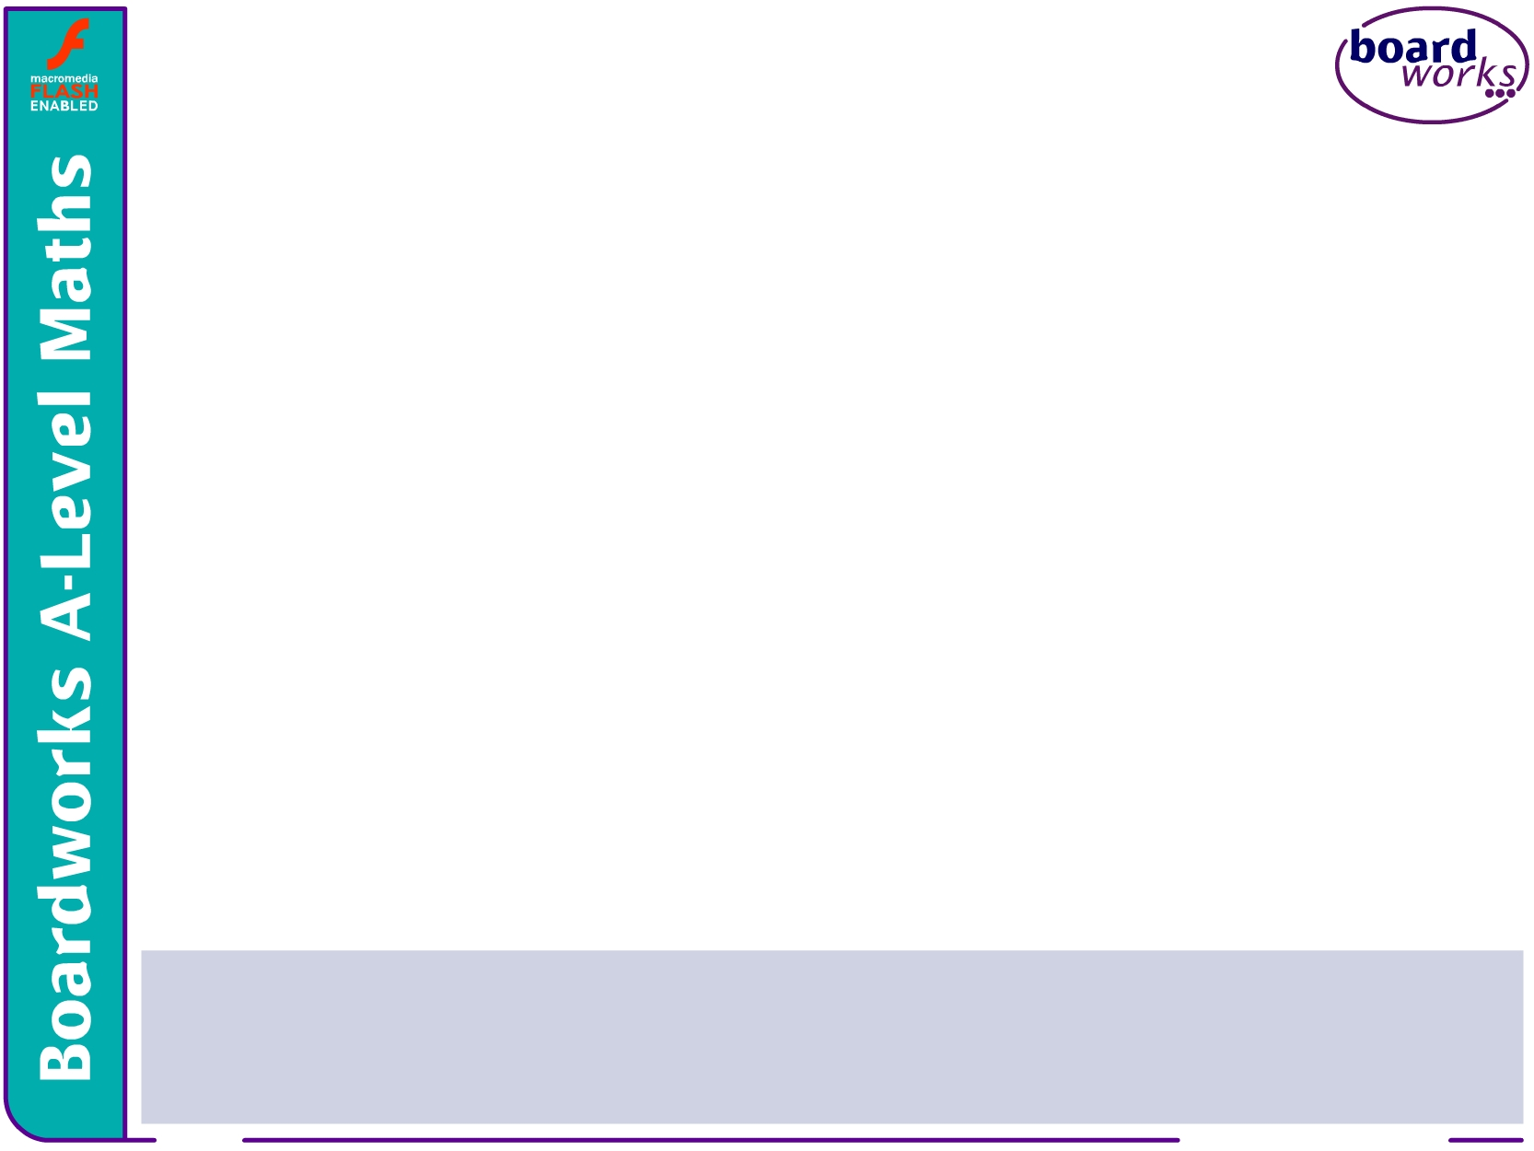


AS-Level Maths:
Core 1 for Edexcel
C1.8 Integration
This icon indicates the slide contains activities created in Flash. These activities are not editable.
For more detailed instructions, see the Getting Started presentation.
<number> of 18
© Boardworks Ltd 2005

Slide 2



Reversing the process of differentiation
Reversing the process of differentiation
Indefinite integration
Rewriting expressions before integrating
Finding the constant of integration given a point
Examination-style questions
Contents
<number> of 18
© Boardworks Ltd 2005

Slide 3

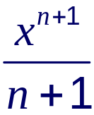
Reversing the process of differentiation
To differentiate y = x^{n} with respect to x we multiply by the power and reduce the power by one.
We can write this process as follows:
x^{n}
multiply by the power
reduce the power by 1
nx^{n-1}
Suppose we are given the derivative = x^{n} and asked to find y in terms of x.
Reversing the process of differentiation given above would give
divide by the power
increase the power by 1
x^{n}

Slide 4
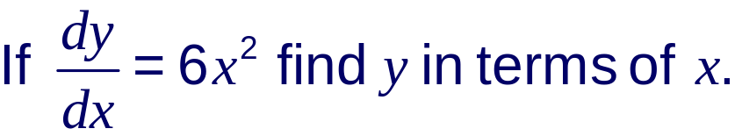
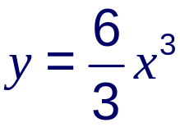
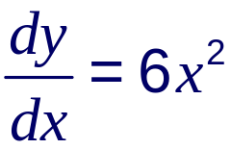
Reversing the process of differentiation
For example:
Adding 1 to the power and dividing by the new power gives:
= 2x³
This is not the complete solution, however, because if we differentiated y = 2x³ + 1,
or y = 2x³ – 3,
or y = 2x³ + any constant
we would also get
We therefore have to write y = 2x³ + c.

Slide 5
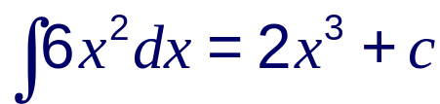
Reversing the process of differentiation
We can’t find the value of c without being given further information. It is an arbitrary constant.
The process of finding a function given its derivative is called integration.
We call c the constant of integration.
The integral of 6x² with respect to x is written as:
This is called an indefinite integral because we don’t know the value of c.
Notes:
Tell students that the integral symbol is derived from an elongated S. The reason for this will be explained when integration is used to find the area under a curve.

Slide 6
Indefinite integration
Reversing the process of differentiation
Indefinite integration
Rewriting expressions before integrating
Finding the constant of integration given a point
Examination-style questions
Contents
<number> of 18
© Boardworks Ltd 2005

Slide 7
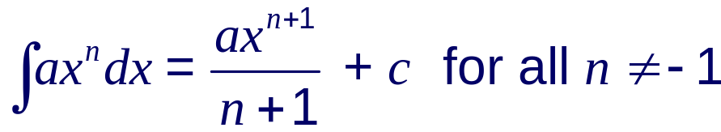
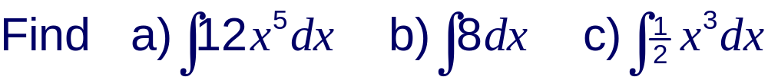
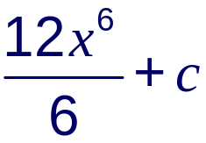
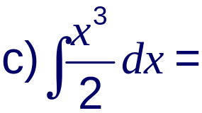
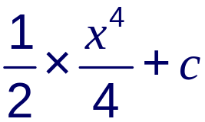
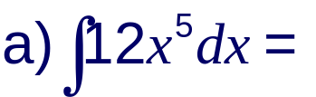
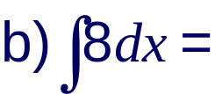

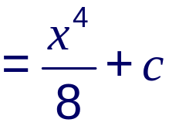

Indefinite integration
In general:
For example:
Notes:
Discuss the fact that we can find the integral of ¹/_{x} using this method since it would lead to a division by 0, which is undefined. The integral of ¹/_{x} as ln x is introduced in C3.
Talk through each of the three examples.

Slide 8
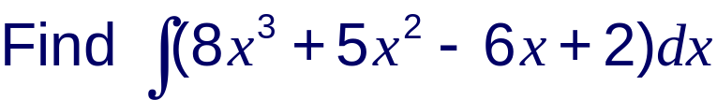
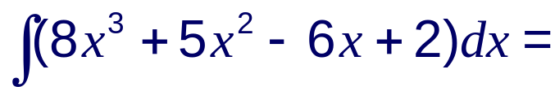
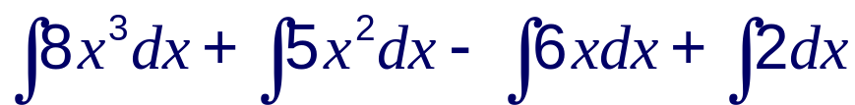
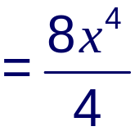
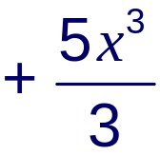
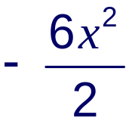



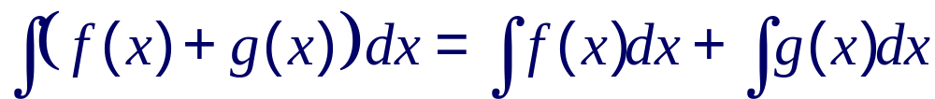
Integration of polynomials
When we differentiated polynomials we differentiated each term at a time.
The same can be done when polynomials are integrated.
For example:
In general:
Notes:
Point out to students that when the integral sign is used to integrate a polynomial with respect to x, brackets should be placed around the polynomial.
It is not usually necessary to write the integrals of each of the terms when a polynomial is integrated. Each term can be integrated directly.
Note that we don’t have to add on a different constant for each integral. We can just add c at the end to represent the sum of all the constants.

Slide 9
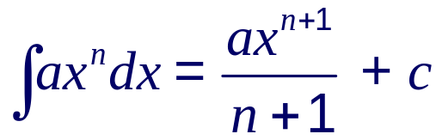
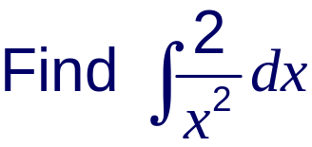
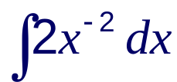

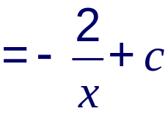
Integration of ax^{n} for all rational n
The rule
can be applied to all negative or fractional values of n except n = –1.
For example:
Start by writing this as

Slide 10
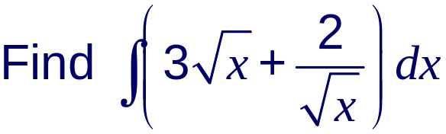
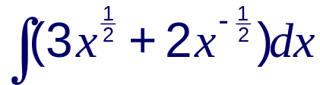
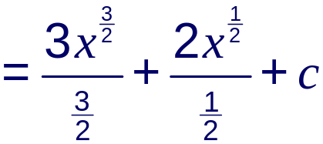



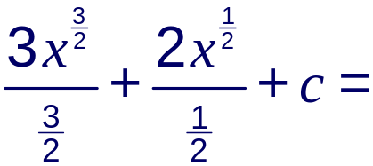



Integration of ax^{n} for all rational n
This can be written as
Remember, to divide by we multiply by and to divide by we multiply by 2. So
Notes:
For examples such as these students should be able to confidently divide by fractions.

Slide 11
Rewriting expressions before integrating
Reversing the process of differentiation
Indefinite integration
Rewriting expressions before integrating
Finding the constant of integration given a point
Examination-style questions
Contents
<number> of 18
© Boardworks Ltd 2005

Slide 12
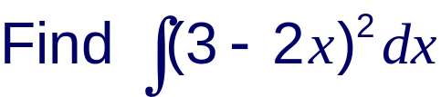
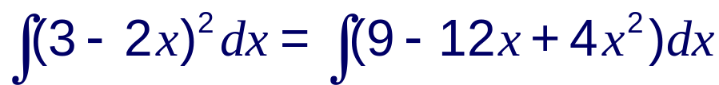
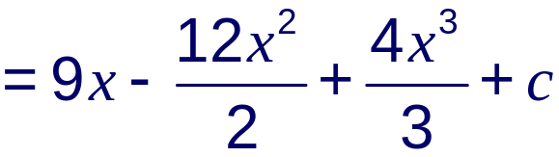
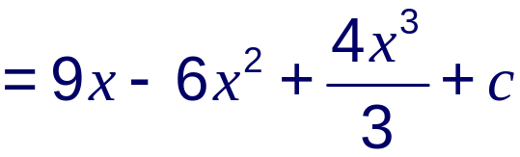
Rewriting expressions before integrating
As with differentiation, some expressions will need to be rewritten as separate terms of the form ax^{n} before integrating. For example:
Expanding the brackets gives:

Slide 13
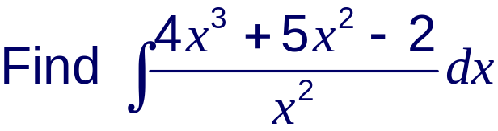
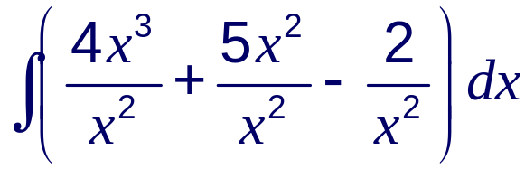
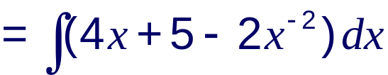
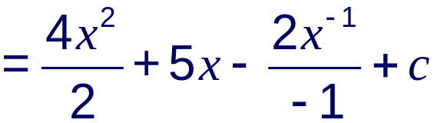

Rewriting expressions before integrating
We can write this as

Slide 14
Finding the constant of integration
Reversing the process of differentiation
Indefinite integration
Rewriting expressions before integrating
Finding the constant of integration given a point
Examination-style questions
Contents
<number> of 18
© Boardworks Ltd 2005

Slide 15
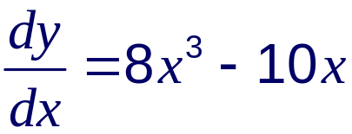
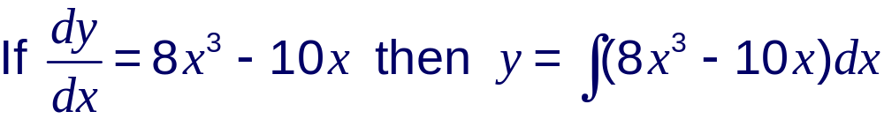
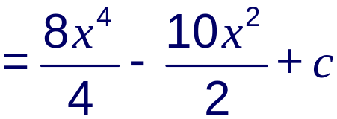

Finding the constant of integration given a point
Suppose we know the gradient function of a curve and we want to find its equation.
We can do this by integration if we are also given a point on the curve.
This is because we can use the coordinates of the point to find the constant of integration. For example:
A curve y = f(x) passes through the point (2, 9).
Given that
find the equation of the curve.

Slide 16
Finding the constant of integration given a point
The curve passes through the point (2, 9) and so we can substitute x = 2 and y = 9 into the equation of the curve to find the value of c.
y = 2x⁴ – 5x² + c
9 = 2(2)⁴ – 5(2)² + c
9 = 32 – 20 + c
9 = 12 + c
c = –3
So the equation of the curve is y = 2x⁴ – 5x² – 3.

Slide 17
Examination-style questions
Reversing the process of differentiation
Indefinite integration
Rewriting expressions before integrating
Finding the constant of integration given a point
Examination-style questions
Contents
<number> of 18
© Boardworks Ltd 2005

Slide 18
Examination-style question
A curve has gradient function 6x² – 7. Given that the curve passes through the point with coordinates (2, 5) find the equation of the curve.
f ’(x) = 6x² – 7
f(x) = 2x³ – 7x + c
Substituting x = 2 and y = 5 into this equation gives:
5 = 16 – 14 + c
c = 3
So the equation of the curve is y = 2x³ – 7x + 3.

